Slide 1
Chunking: Summing it up
By Barbara Oakley, PhD

Slide 2
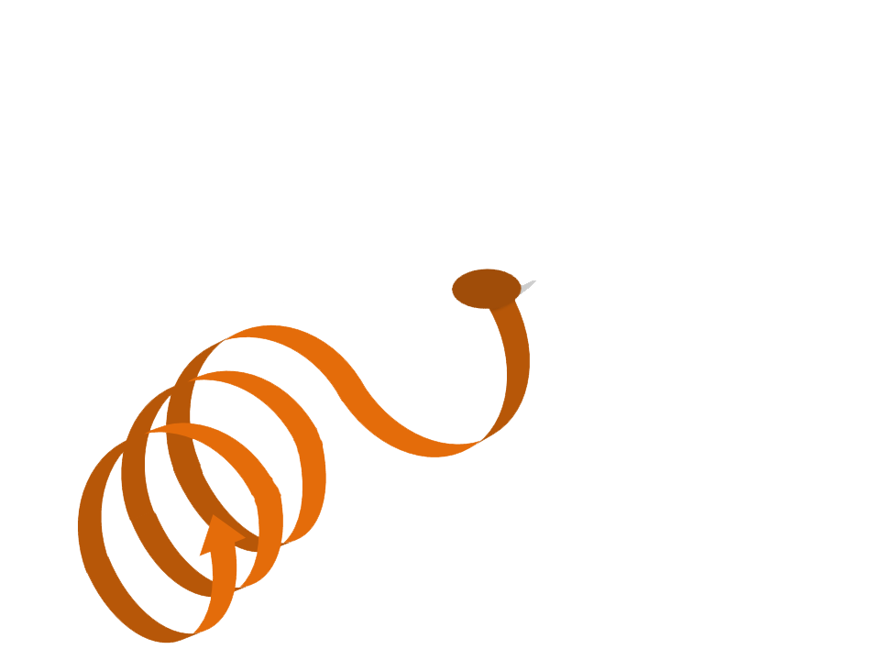
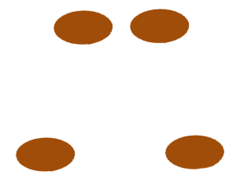

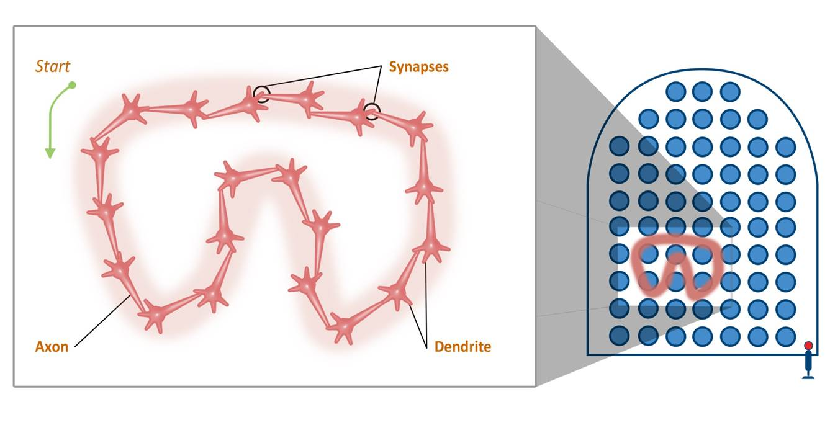

Slide 3
Chunks are best built with
Focused attention
Understanding
Practice

Slide 4
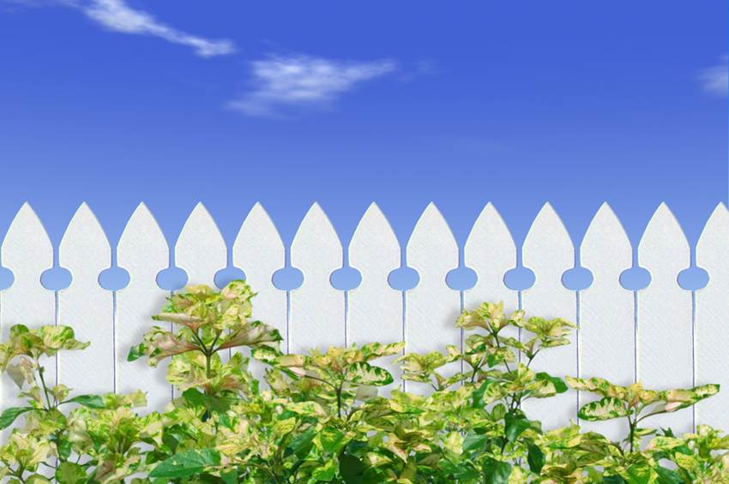
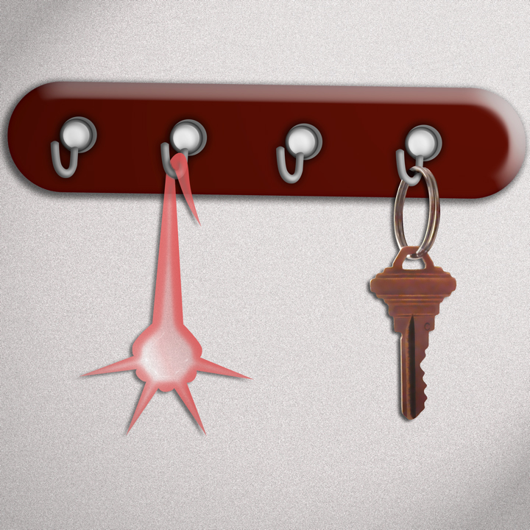
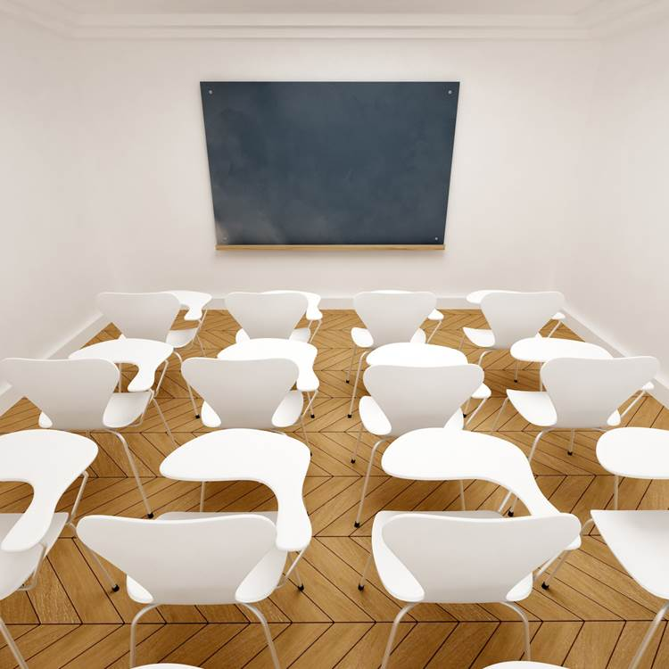
Recall

Slide 5
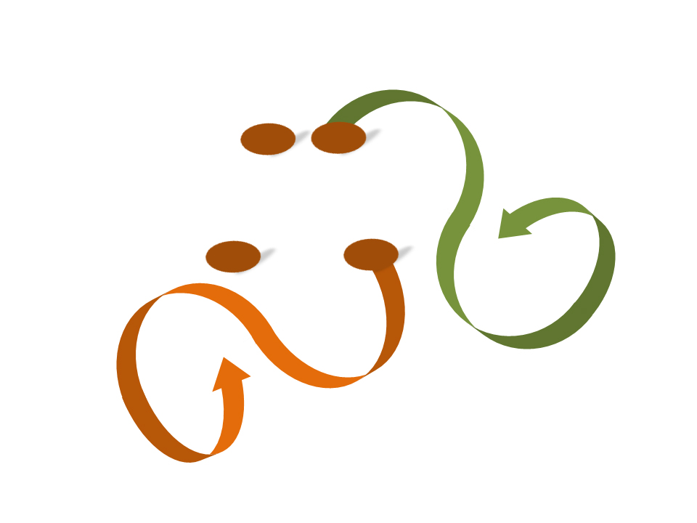
Transfer

Slide 6
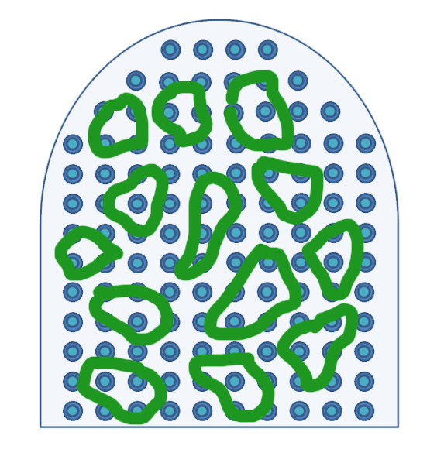
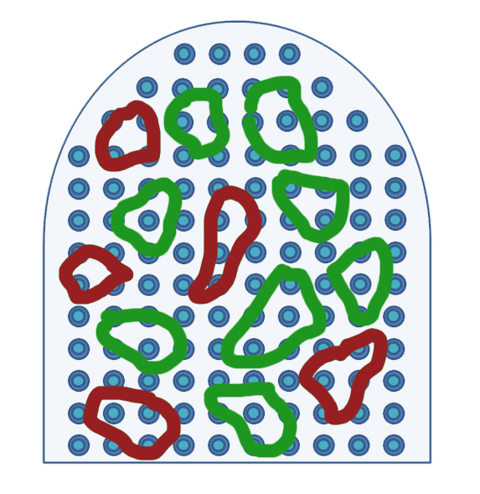
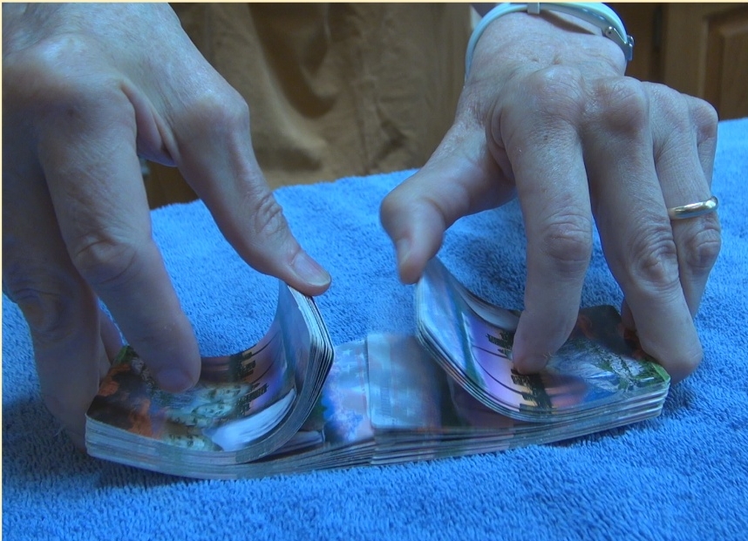
Interleave your learning

Slide 7
Illusions of competence in learning
Test yourself!
Minimize highlighting
Mistakes are good!
Use deliberate practice.

Slide 8
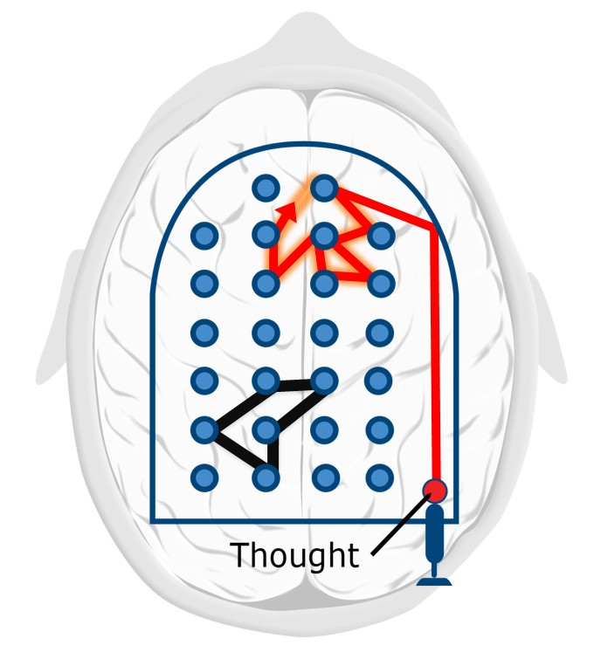


Einstellung

Slide 9

The Law of Serendipity
Lady Luck favors the one who tries.

Slide 10
Illustration credits
Chunked ribbons © Barbara Oakley, 2014.
Pinball neural patterns ©Barbara Oakley, 2014.
Firing neurons, ©Kevin Mendez, 2014.
Neural hook, ©Kevin Mendez, 2014.
Interleaved cards © Barbara Oakley, 2014.
Einstellung, ©Kevin Mendez and Barbara Oakley, 2014.
Man in the Mustang, ©Kevin Mendez and Philip Oakley, 2014.
Lady Luck, ©Kevin Mendez, 2014.
Microsoft clip art courtesy Microsoft Corporation.

